Slide 1


Advanced Note-Taking Application with User Authentication
Project by Team Innovate | Spring 2024 Semester
by Haseeb Jalil

Slide 2
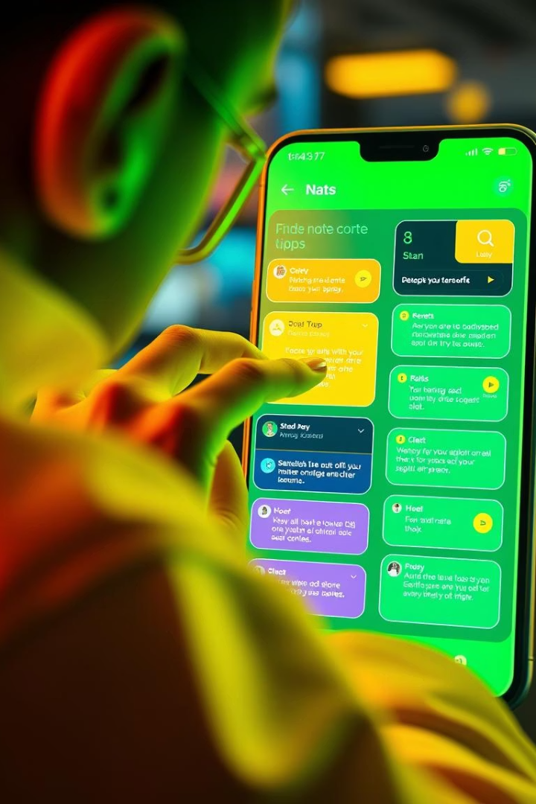
Project Introduction and Features
Project Goal
Create a secure, flexible note-taking app for multiple users.
Core Features
Note creation and management
User login and authentication
File saving with user-specific storage

Slide 3
Modular System Architecture
Note Class
User Class
NoteManager
AuthManager
Abstract base for all note types.
Manages user-specific data.
Handles note operations and storage.
Controls signup and login processes.

Slide 4

Implementing OOP Principles
Abstraction
Abstract Note class defines common note behavior.
Inheritance
Derived classes for different note types extend Note.
Encapsulation
User data and notes' details are securely hidden.
Polymorphism
NoteManager treats all note types uniformly via base class pointers.

Slide 5
Class Overview and Relationships
Note & Derived Classes
NoteManager
User
AuthManager
Manages notes lifecycle and storage.
Holds user credentials and preferences.
Handles authentication workflows.
Define different note formats and content.

Slide 6




File Handling and Storage
Save Notes
Write note data to user-specific files.
Load Notes
Retrieve notes from storage on login.
User Folders
Each user's notes are stored in separate directories.

Slide 7
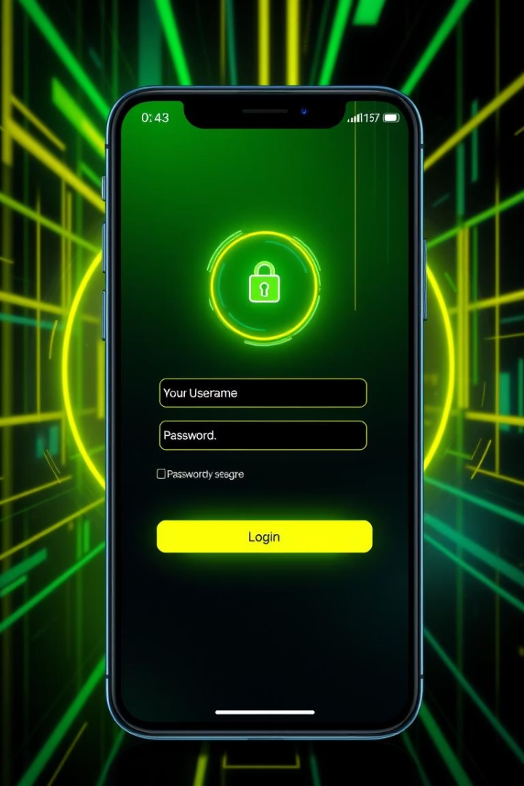
User Authentication Process
Signup
Collect and store user credentials securely.
Login
Validate credentials to grant access.
Validation
Check inputs against stored user data.

Slide 8

Summary and Future Directions
Benefits
Future Improvements
OOP enhances maintainability and scalability of the application.
Implement password hashing for better security
Develop a graphical user interface (GUI)
Extend support for advanced note types and syncing

